Slide 1
Excel Project
Contoso
Customer Success Team
September 3, 2023

Slide 2
Agenda
01. Introduction
02. Data Cleaning and analysis
Description of the data set
Cleaning the Data to get useful insights.
03. Excel Functions
04. Visualization
05. Power BI
Graphs and charts
Visual representation

Slide 3


Introduction
The data provided to our team was a cumulative vaccine data for the whole country.
A four month window of data was given in the data set.
Primarily the columns consisted of first dose, second dose, covaxin ,covishied data distributed along all the states

Slide 4
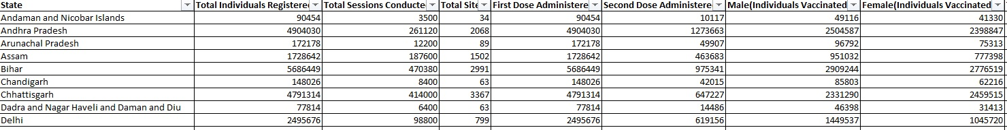

Slide 5
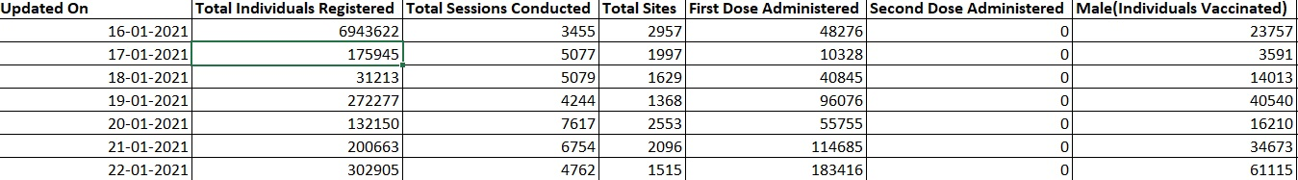
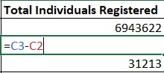
To get useful sense from the data, we converted the cumulative data by subtracting values from the next cell by previous cell and storing it the in the same cell.
Basic formula to convert cumulative data
For the ease of working data set for India as a whole state was extracted.
The time frame of this data set was from 16 January 2021 to 17 April 2021.

Slide 6
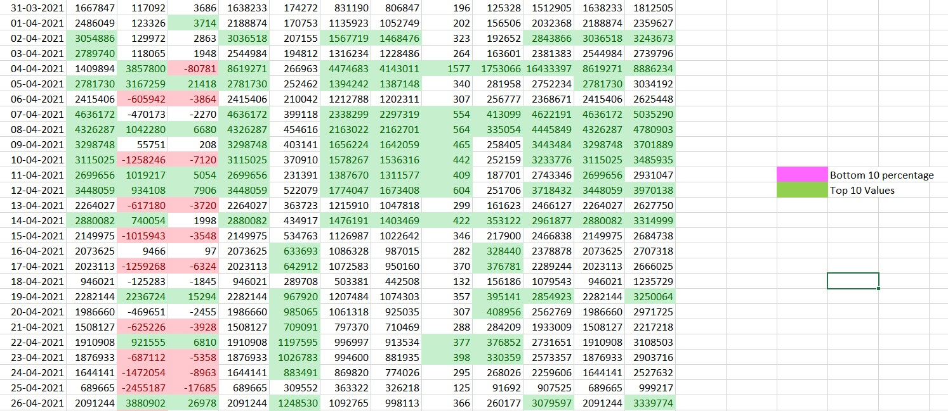
Conditional Formatting on India Data set

Slide 7
Graphs and Charts for the Data set (India)
From the Line chart positive trend can be seen for the doses that are being administered.

Slide 9

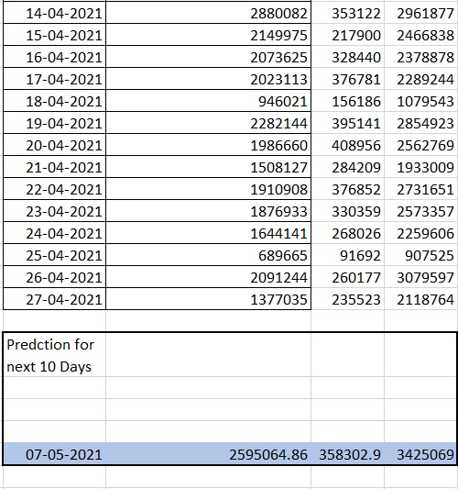

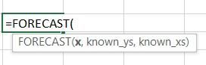
Using for Forecast Function to predict values for next 10 days
X= date we want to predict value for. Eg – 07-05-2021
Known_ys= Total Individual Registered
Known_xs= Updated on

Slide 10
Graphical Evidence to support Forecasted Values
The trendline in orange colour predicts the value after 10 days to be around 2500000.
The value coming from formula is 2595064
2500000
Graphically and Numerically both results are verified.

Slide 11
Graphical Evidence to support Forecasted Values
The trendline in orange colour predicts the value after 10 days to be around 350000.
The value coming from formula is 358302
350000
The trendline in orange colour predicts the value after 10 days to be around 3500000.
The value coming from formula is 3425069
350000

Slide 12
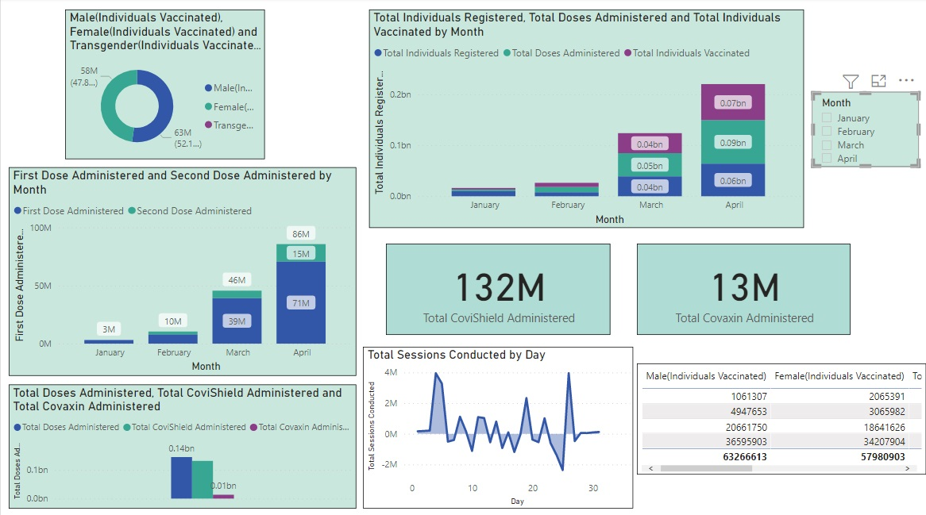
Power BI Dashboard
Dashboard for data considering India as a whole country

Slide 13
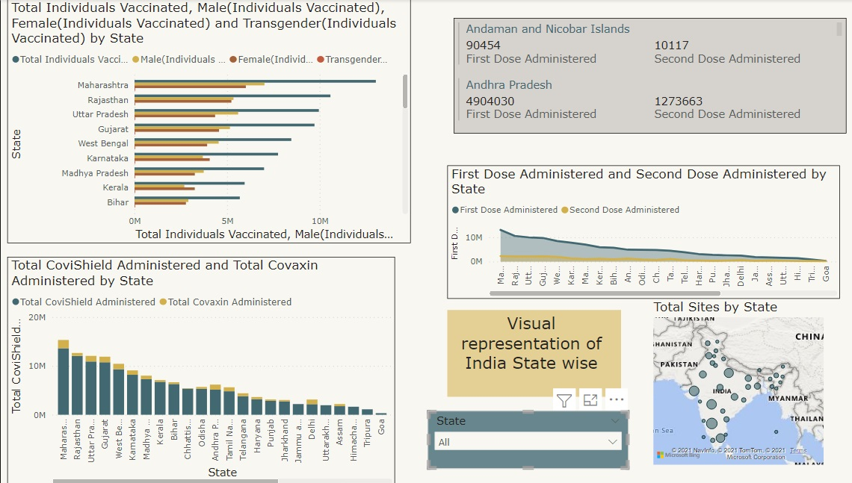
Dashboard for states

Slide 14

Thank you
Thanks to your commitment and strong work ethic, we know next year will be even better than the last.
We look forward to working together.
Contoso
sales@contoso.com

